Slide 1
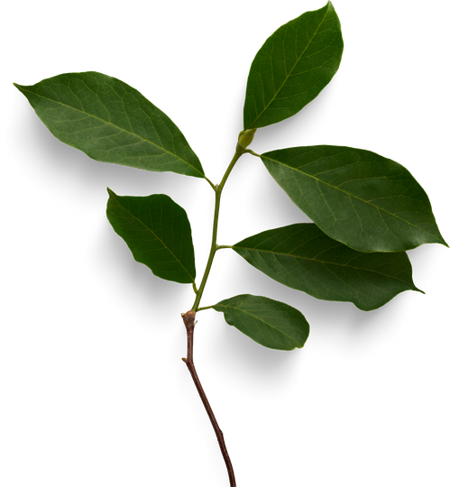

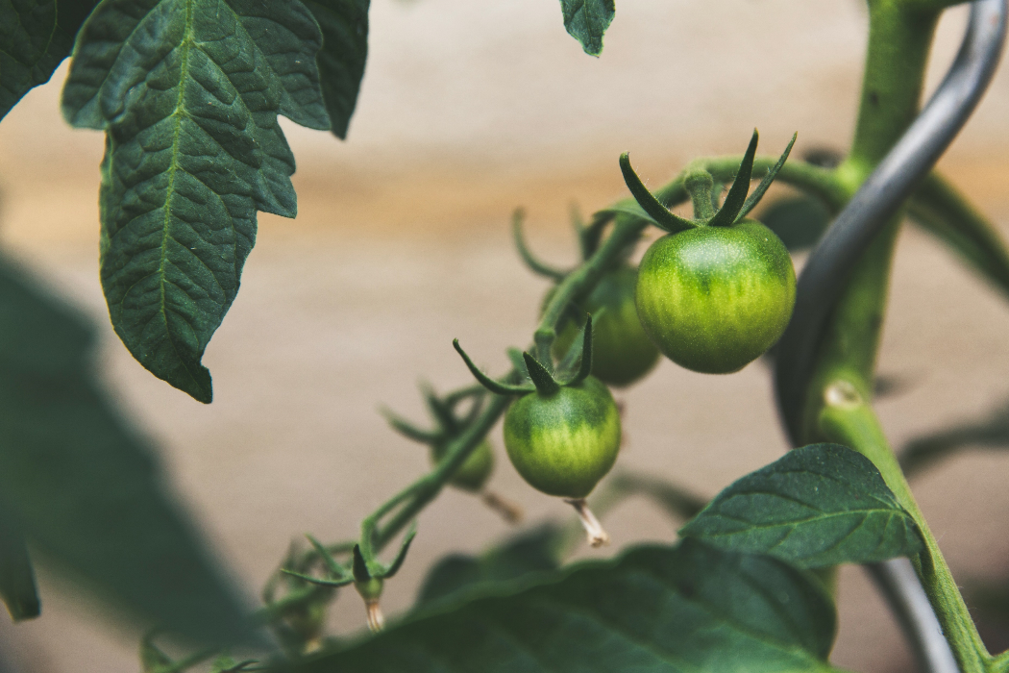
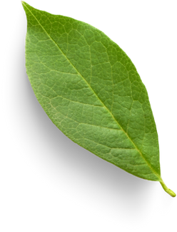
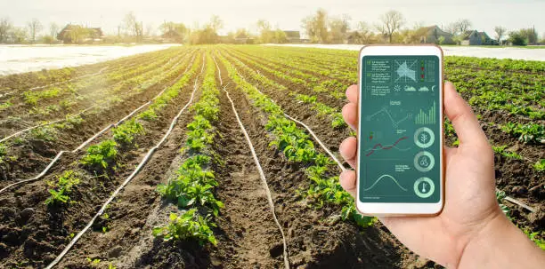

Sustainable Greenhouse Management through Smart Technology Integration
Project ID:24-25j-250

Slide 2
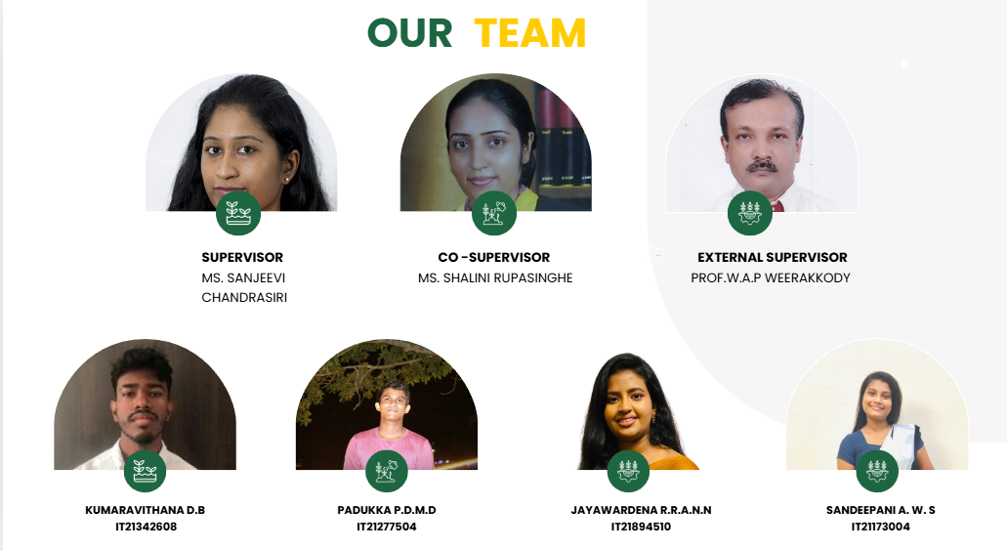
24-25J-250
Page 2

Slide 3
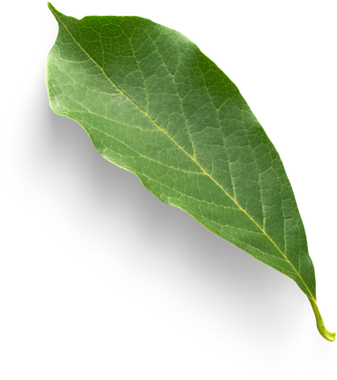
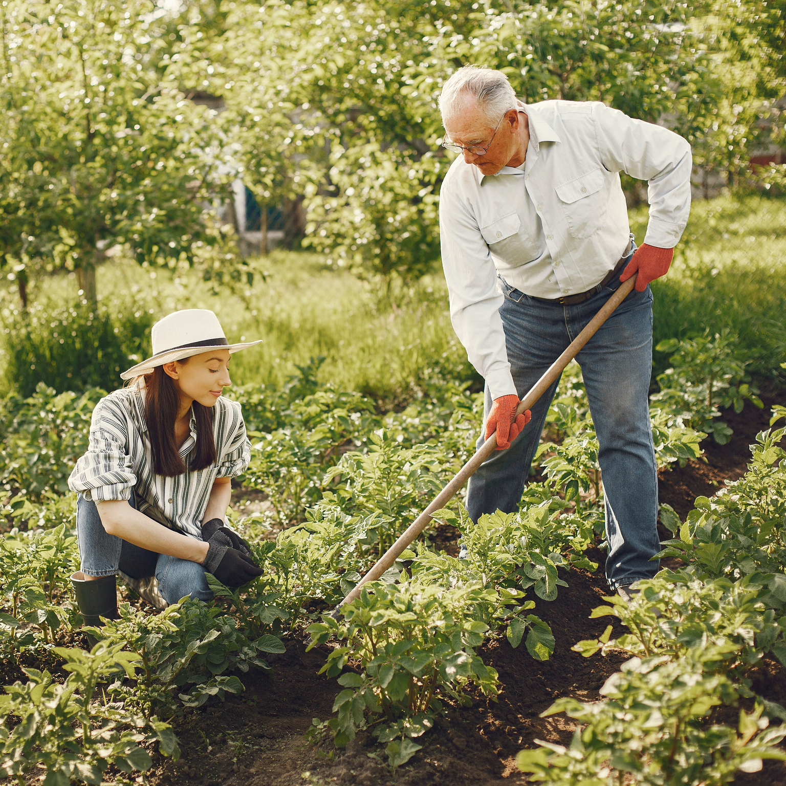
Background
Agriculture faces challenges in disease detection, disease severity classification, pest management, and resource optimization. Traditional methods are slow and error-prone, while machine learning, particularly deep learning models like CNNs and YOLOv8, automate disease identification and severity classification, pest monitoring, and fruit ripeness prediction. These systems classify disease severity, assess pest infestations, and optimize fertilizer and irrigation use based on factors like soil nutrient levels. Machine learning models such as CatBoost and Random Forest enable data-driven decisions, improving crop yield and sustainability. These technologies enhance efficiency, reduce waste, and promote sustainable farming practices, empowering farmers with actionable insights for better resource management and productivity.
24-25J-250
Page 3

Slide 4
Research Problem
01
How can deep learning improve disease detection and severity classification in tomato crops for faster and more cost-effective interventions?
How does real-time pest monitoring using machine learning reduce pesticide use and improve pest control in greenhouses?
02
How do environmental factors and plant age affect fertilizer and water needs, and can ensemble models improve prediction accuracy?
03
How can deep learning models for fruit ripeness detection help optimize harvest timing, reduce waste, and improve crop yield?
04
24-25J-250
Page 3
Page 4

Slide 5
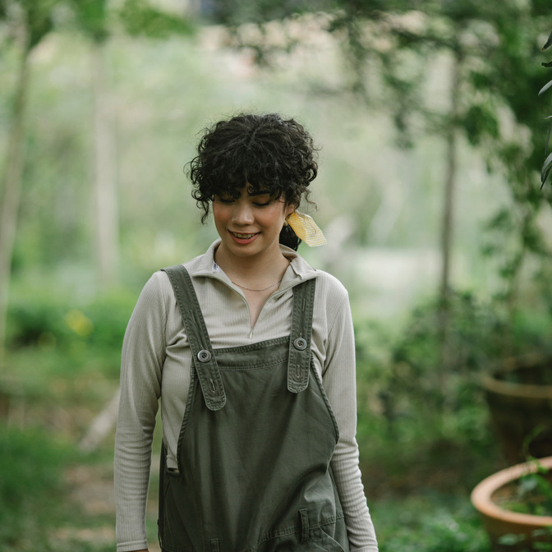
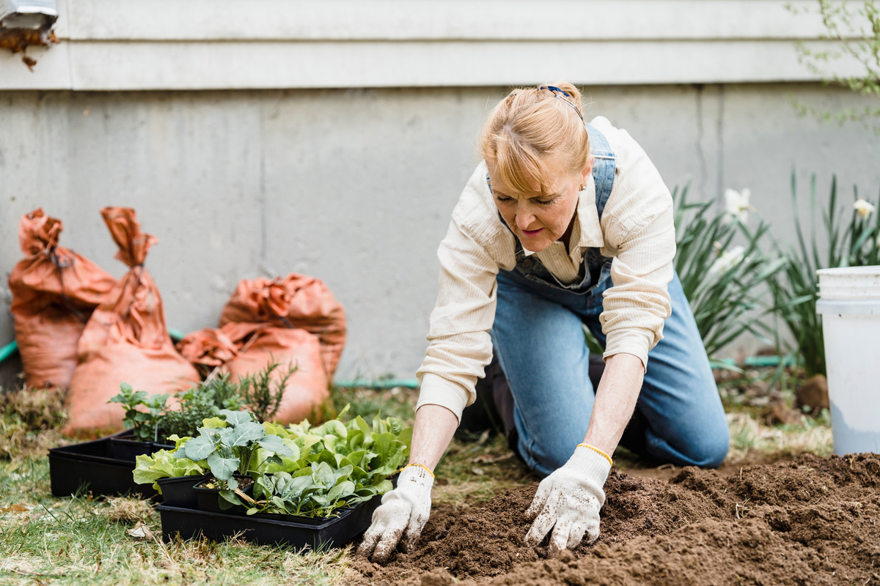
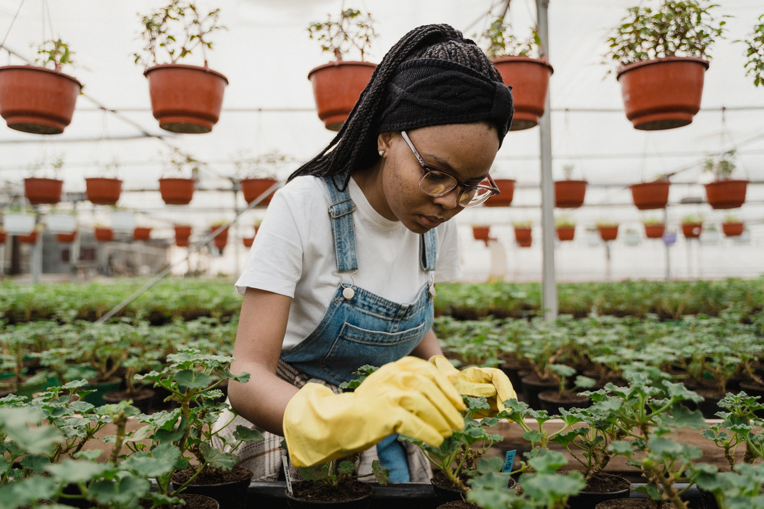
Main Objective
Achieve sustainable greenhouse management through smart technology integration, using IoT sensors, image processing for predictive adjustments, and user-friendly interfaces to enhance agricultural efficiency and sustainability.
24-25J-250
Page 5

Slide 6
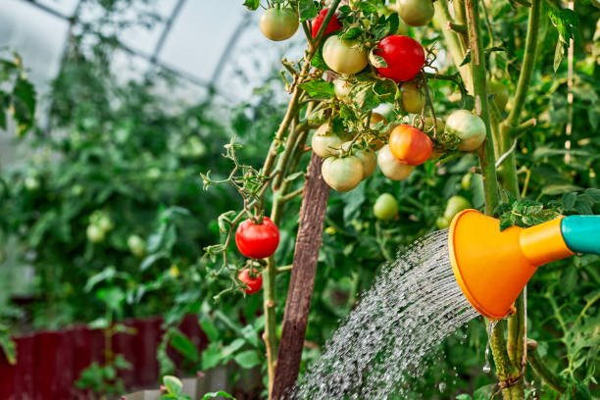
Sub Objectives
Evaluate deep learning models' effectiveness in detecting and classifying tomato disease severity compared to traditional methods.
01
02
Assess real-time pest detection with machine learning's impact on reducing pesticide use in greenhouses.
03
Analyze how environmental variables and plant age affect fertilizer and water predictions using ensemble models.
Investigate deep learning models like YOLOv8 in automating fruit ripeness detection and optimizing harvest timing.
04
04
24-25J-250
Page 6

Slide 7
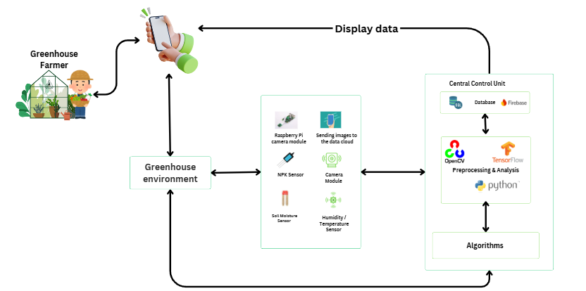
System Diagram
24-25J-250
Page 7

Slide 8

Tomato Disease Detection and Severity Prediction with Management Suggestions
IT21894510 | Jayawardena R.R.A.N.N
Software Engineering
IT21894510 | Jayawardena R.R.A.N.N| 24-25J-250
Page 8
IT21894510 | Jayawardena R.R.A.N.N| 24-25J-250

Slide 9
Background
Tomato diseases, caused by bacterial, fungal, or viral infections, significantly impact crop yield and quality. Traditional detection methods are slow and prone to errors. To address this, machine learning, particularly deep learning with Convolutional Neural Networks (CNNs), is used for automated disease identification from images. A key feature of this system is classifying disease severity (mild, moderate, severe), which helps determine the appropriate treatment or intervention. This approach streamlines disease detection, providing farmers with timely, data-driven recommendations to improve crop health and productivity.
IT21894510 | Jayawardena R.R.A.N.N| 24-25J-250
Page 9

Slide 10
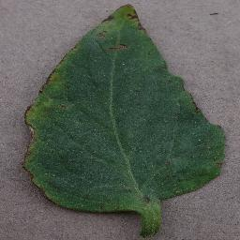
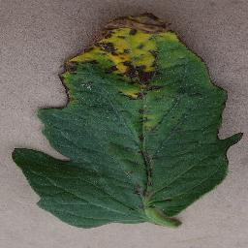
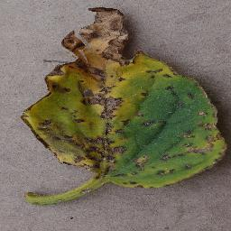
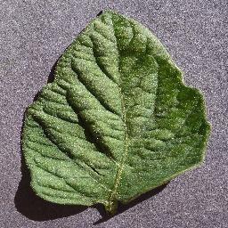
Research Question?
01
How can deep learning improve the accuracy of detecting tomato diseases and determining their severity?
How does automating disease severity classification help in making faster and better decisions for tomato crop management?
02
How can severity-based recommendations improve the treatment and control of tomato diseases?
03
IT21894510 | Jayawardena R.R.A.N.N| 24-25J-250
Page 10

Slide 11
Objectives
To develop and implement a deep learning-based system for the automated detection and severity classification of tomato diseases and provide actionable recommendations to improve crop health and yield.
IT21894510 | Jayawardena R.R.A.N.N| 24-25J-250
Page 11

Slide 12
Sub Objectives
01
Disease Detection
The system automatically detects tomato plant diseases by analyzing images and identifying symptoms of bacterial, fungal, or viral infections.
02
Severity Classification
The model classifies the detected diseases into different severity levels (mild, moderate, severe) to assess the extent of the infection.
03
Recommendations for Disease Management based on disease severity
Based on the severity classification, the system provides tailored recommendations to help farmers manage and treat the disease effectively.
04
IT21894510 | Jayawardena R.R.A.N.N| 24-25J-250
Page 12

Slide 13
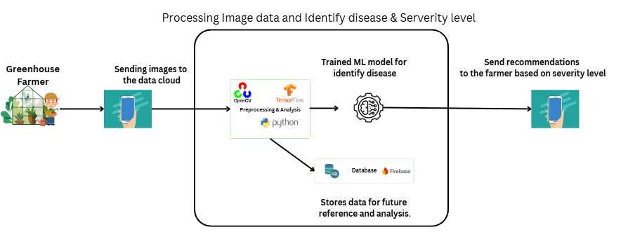
System Diagram
Integrating Trees
IT21894510 | Jayawardena R.R.A.N.N| 24-25J-250
Page 13

Slide 14
Techniques
Technologies
Data Augmentation
Image Preprocessing
VS Code
Python
PyTorch
Timm
Algorithms
Convolutional Neural Networks (CNN)
Adam Optimizer
Train-Test Split
IT21894510 | Jayawardena R.R.A.N.N| 24-25J-250
Page 14

Slide 15
Methodology
Data Collection and Preparation
I used a tomato disease dataset from Kaggle and additional data from Google.
The dataset includes over 1500 images of tomato bacterial diseases, which I classified into three severity levels: mild, moderate, and severe.
Model Architecture
Leveraging EfficientNet B0 for feature extraction, followed by a fully connected layer for classification. The model was pretrained on ImageNet for transfer learning.
Training Process
Cross-entropy loss and Adam optimizer were used for training. The model was trained over 8 epochs using GPU acceleration.
IT21894510 | Jayawardena R.R.A.N.N| 24-25J-250
Page 14

Slide 16


Functional Requirements
Image Input Processing
Disease Detection
Severity Classification
Disease Management Recommendations based on severity
IT21894510 | Jayawardena R.R.A.N.N| 24-25J-250
Page 15

Slide 17
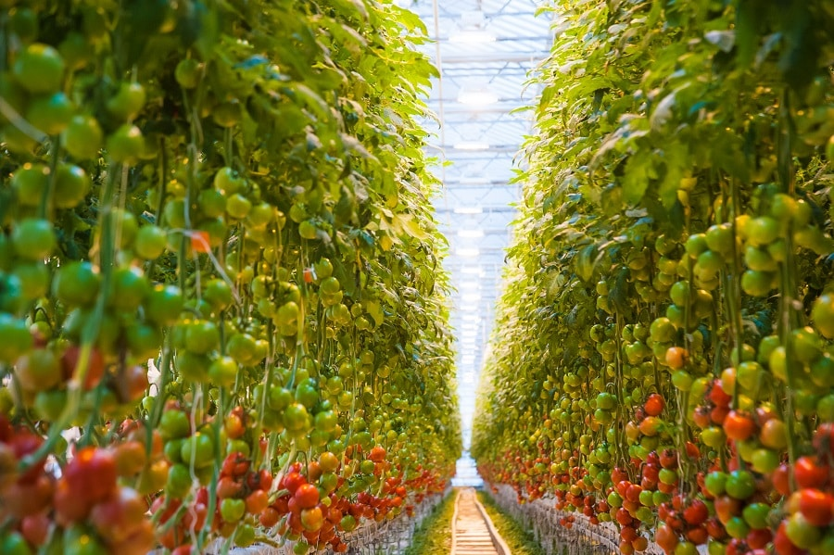
Non-Functional Requirements
Performance
Scalability
Reliability & Availability
Usability
IT21894510 | Jayawardena R.R.A.N.N| 24-25J-250
Page 16

Slide 18
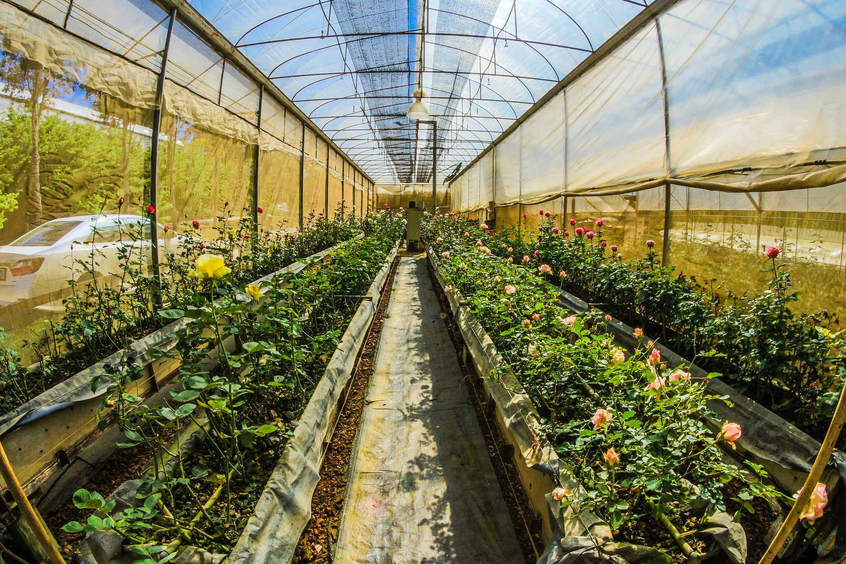
Completed Function (50%)
Disease Detection Model Development
Severity Classification
Recommendations Engine
Future Work
Integration of machine learning
Mobile application development
IT21894510 | Jayawardena R.R.A.N.N| 24-25J-250
Page 17

Slide 19
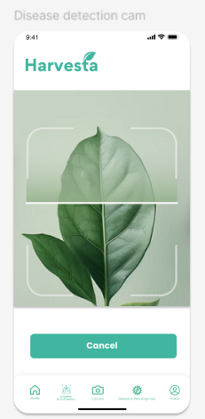
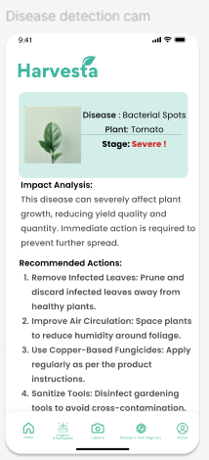
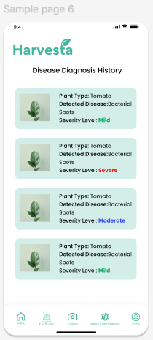
Future work
IT21894510 | Jayawardena R.R.A.N.N| 24-25J-250
Page 18

Slide 20
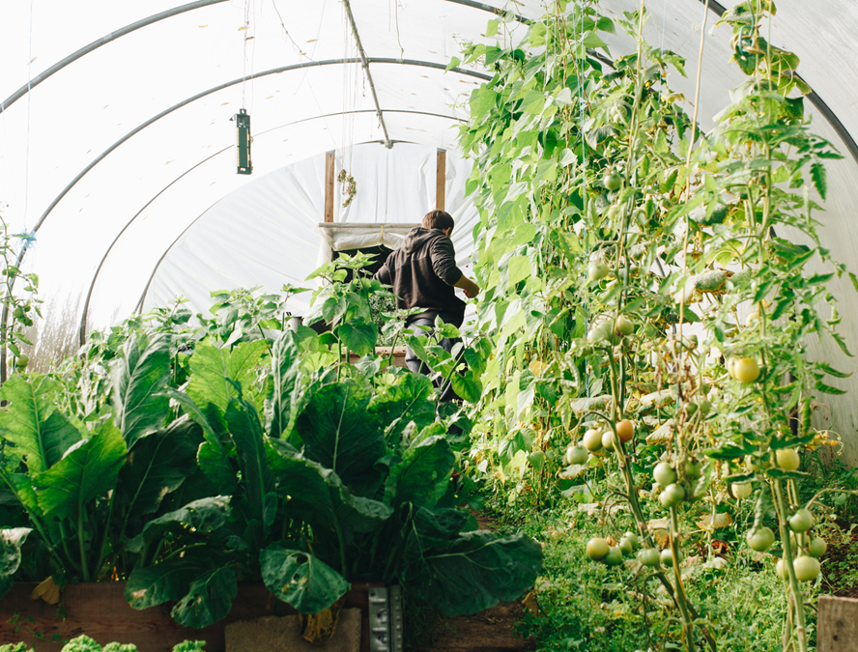
Reference
[1] T. Dharmasena, R. de Silva, N. Abhayasingha, and P. Abeygunawardhana, "Autonomous cloud robotic system for smart agriculture," in *Proc. 2019 Moratuwa Engineering Research Conference (MERCon)*, Moratuwa, Sri Lanka, 2019, pp. 388-393.
[2] S. K. Kumara, R. Weerakkody, and S. Epasinghe, "Viability of Controlled Environmental Agriculture for Vegetable Farmers in Sri Lanka," Hector Kobbekaduwa Agrarian Research and Training Institute, Colombo, Sri Lanka, Tech. Rep., 2015.
[3] T.S. Fernando, R. Nethmi, A. Silva, A. Perera, R. De Silva, and P. K. W. Abeygunawardhana, “Intelligent Disease Detection System for Greenhouse with a Robotic Monitoring System,” 1 in Proc. IEEE Conf. on Advancements in Computing (ICAC), 2020, pp. 1-7.
[4] Zhang, M., et al. (2020). "A deep learning model for predicting risks of crop pests and diseases from sequential environmental data." Journal of Plant Pathology.
Page 19

Slide 21
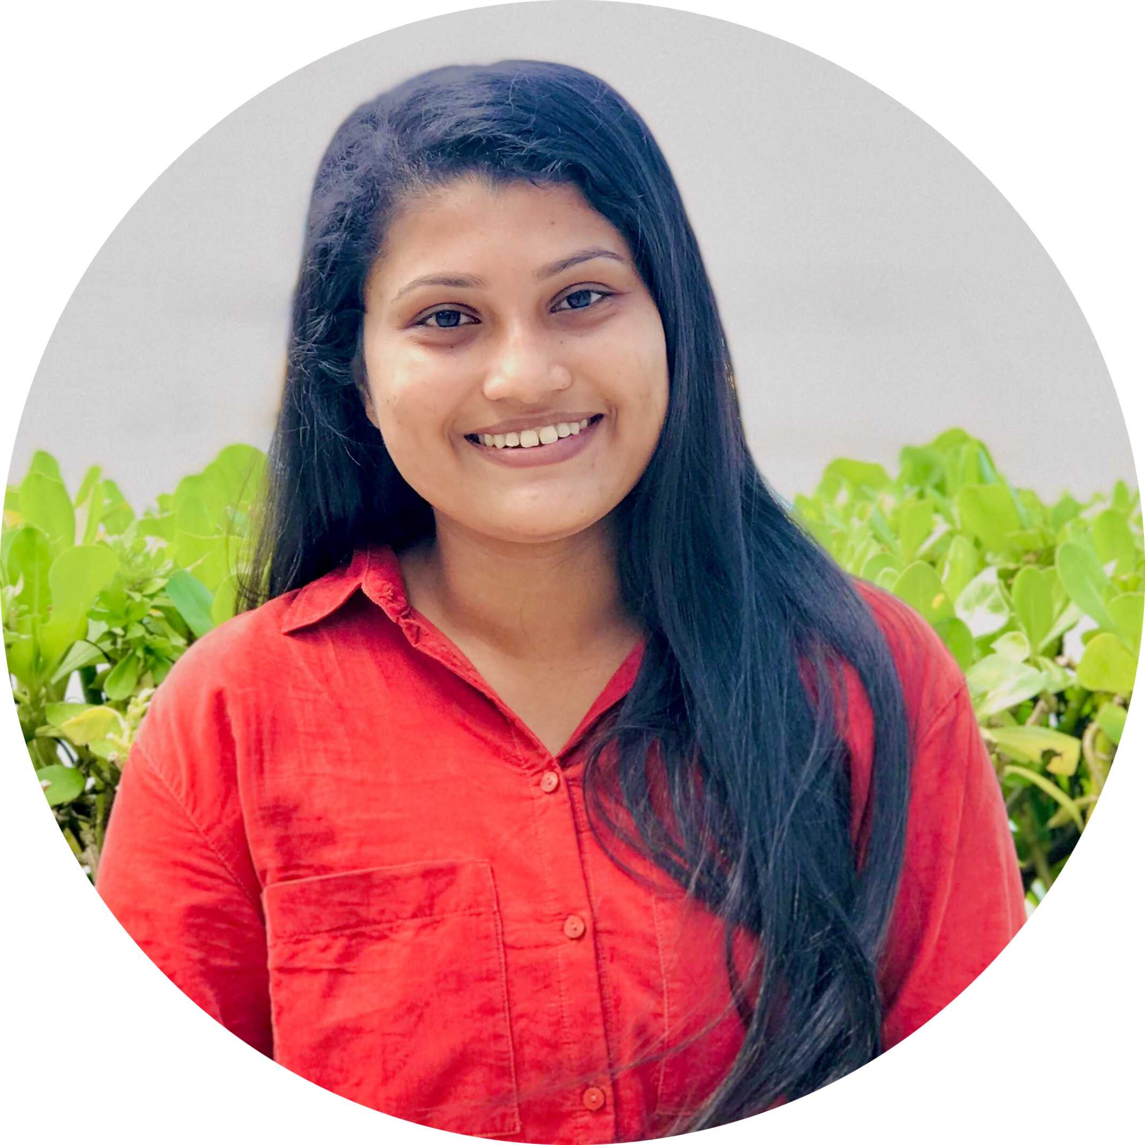
Pest Identification and Management System
IT21173004 | Sandeepani A.W.S
Software Engineering
IT21173004| Sandeepani A.W.S | 24-25J-250
Page 20

Slide 22
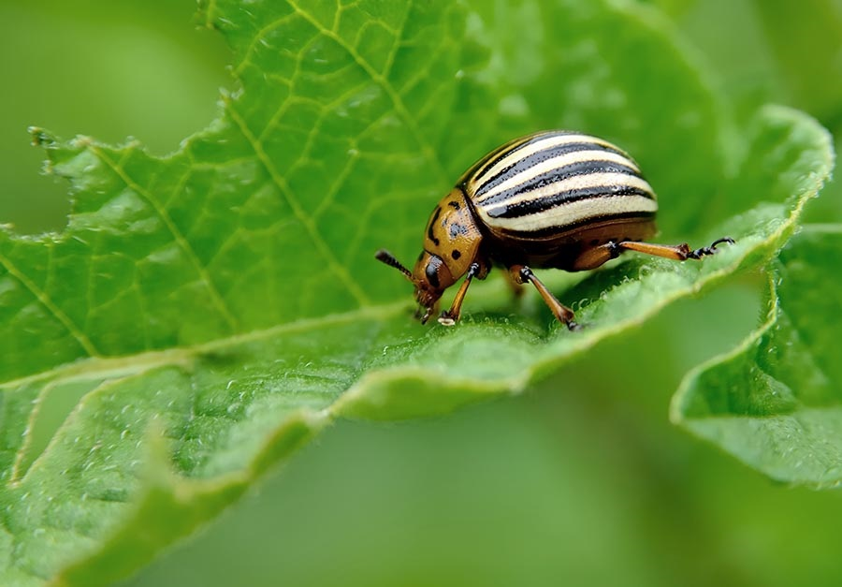
Background
Pest management involves identifying and mitigating pests that harm crops. Advanced systems use, image processing, and AI for automated pest identification and monitoring. These tools classify pests, assess infestation levels, and suggest remedies, enabling farmers to reduce crop losses, minimize pesticide use, and promote sustainable farming practices.
IT21173004| Sandeepani A.W.S | 24-25J-250
Page 21

Slide 23
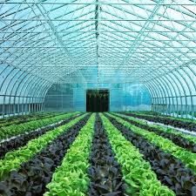
Research Question?
Determine the most effective machine learning techniques for identifying and classifying pests from high-resolution images
01
The effectiveness of the user interface in delivering actionable pest control recommendations
02
IT21173004| Sandeepani A.W.S | 24-25J-250
Page 22

Slide 24
Objectives
The main objective is to develop an advanced pest identification and management system, control using organic pesticides, decision support, and image processing to enhance pest control efficiency, reduce pesticide usage, and promote sustainable agriculture.
IT21173004| Sandeepani A.W.S | 24-25J-250
Page 23

Slide 25
Sub Objectives
01
The system identifies and classifies pests affecting crops by analyzing images, enabling precise identification of harmful species.
02
Use high-resolution images and machine learning for accurate pest identification
03
Based on pest type and potential harm, the system provides tailored remedies, including biological controls, cultural practices, and eco –friendly pesticides, to help farmers mitigate damage effectively
04
IT21173004| Sandeepani A.W.S | 24-25J-250
Page 24

Slide 26
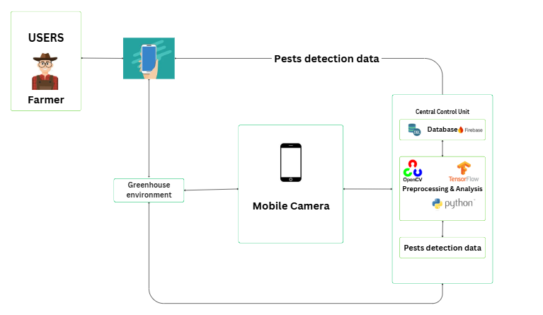
System Diagram
Integrating Trees
IT21173004| Sandeepani A.W.S | 24-25J-250
Page 25

Slide 27
Completed Function (50%)
01
Trained Model
Model has successfully trained to identified the pest from an image, It outputs the identified pest name
02
Harms and Remedies Suggestion
After Identifying the pest It suggest the harms that can happen to the plant
And it suggests the remedies for the relevant identified pest
IT21173004| Sandeepani A.W.S | 24-25J-250
Page 47

Slide 28
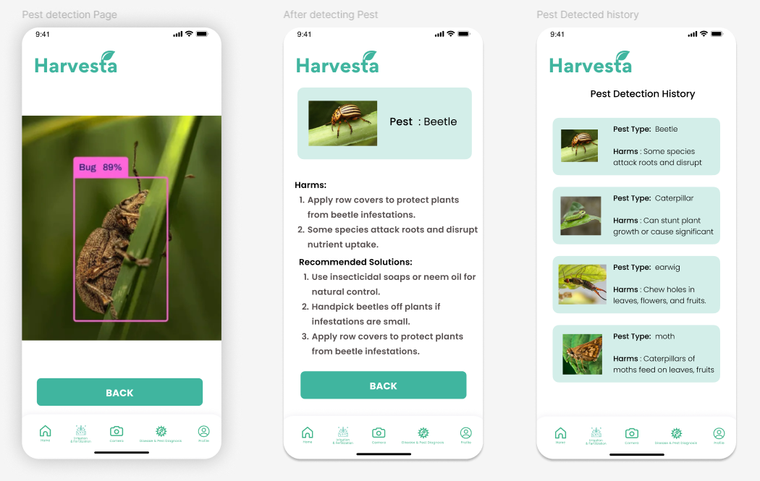
Future work
IT21173004| Sandeepani A.W.S | 24-25J-250
Page 18

Slide 29
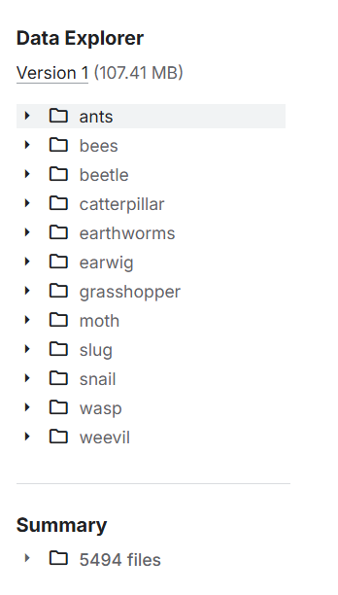
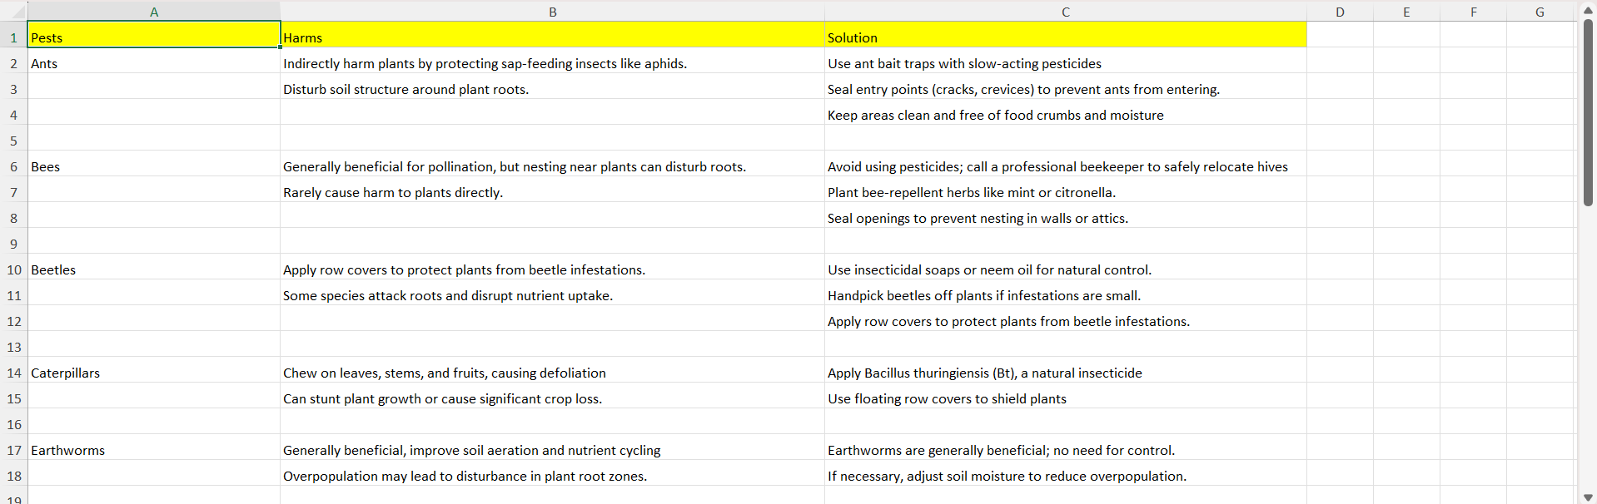
Data Collection
IT21277504 | Padukka P.D.M.D | 24-25J-250
Page 34

Slide 30
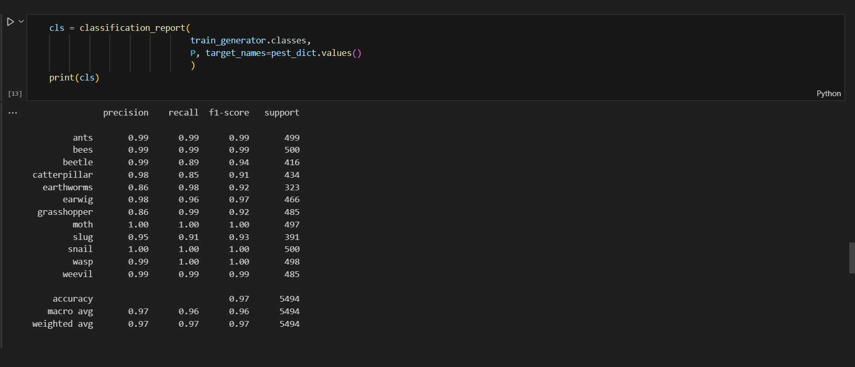
Model's Accuracy
IT21277504 | Padukka P.D.M.D | 24-25J-250
Page 34

Slide 31
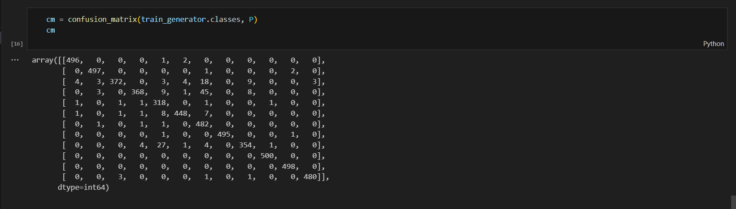
Model's Accuracy
IT21277504 | Padukka P.D.M.D | 24-25J-250
Page 34

Slide 32

Enhancing Fertilization and
Irrigation Management with Real Time Plant Absorption Data
IT21277504 | Padukka P.D.M.D
Software Engineering
IT21277504 | Padukka P.D.M.D | 24-25J-250
IT21277504 | Padukka P.D.M.D | 24-25J-250
IT21277504 | Padukka P.D.M.D | 24-25J-250
IT21277504 | Padukka P.D.M.D | 24-25J-250
Page 28

Slide 33
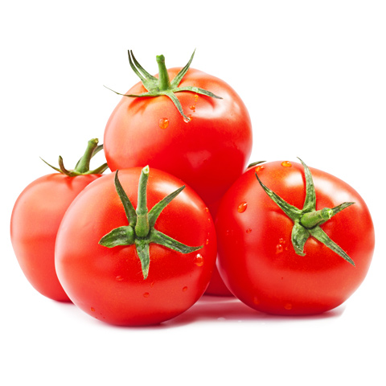
Background
This function focuses on predicting the optimal amounts of fertilizer and irrigation needed for plant growth using machine learning. By analyzing factors such as plant age, soil nutrient levels (NPK), and fertilizer type, we aim to develop accurate models that help optimize resource usage. The models, including CatBoost, LightGBM, Random Forest, and an ensemble method (Voting Regressor), will assist farmers in making data-driven decisions. The ultimate goal is to enhance agricultural efficiency, reduce resource waste, and improve crop yield sustainability.
2
03
04
IT21277504 | Padukka P.D.M.D | 24-25J-250
Page 29

Slide 34
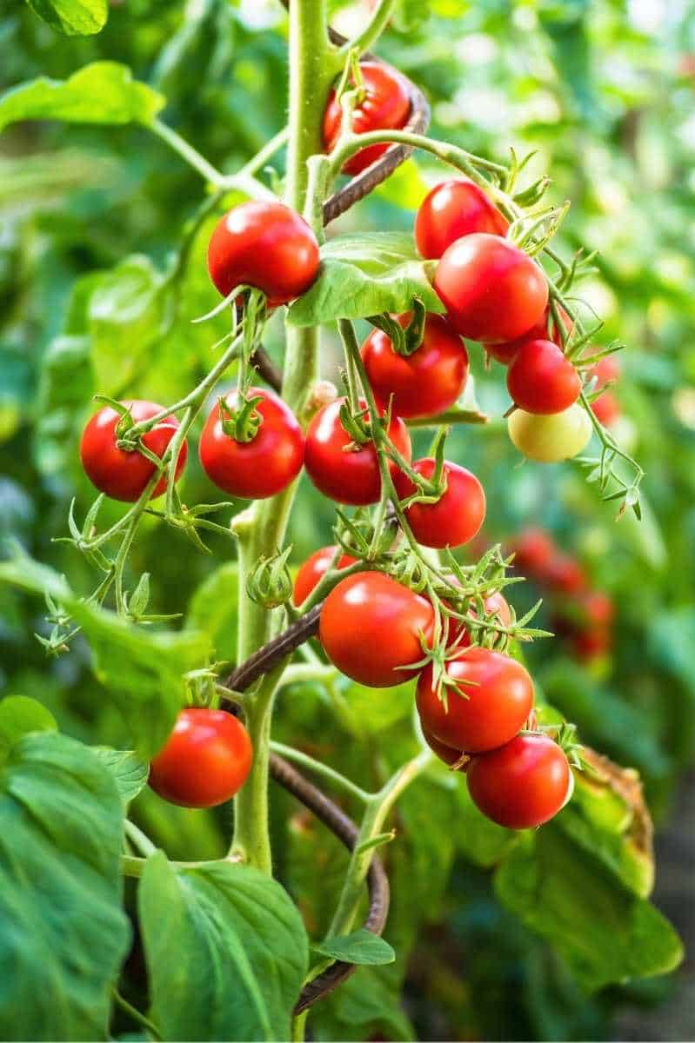
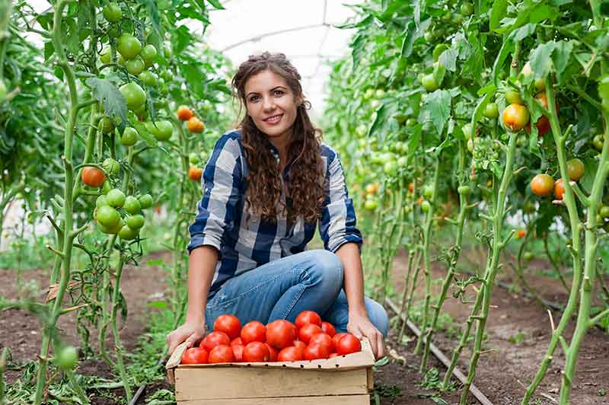
Research Question?
How do different NPK values, plant age, and fertilizer types influence the optimal amount of fertilizer needed for plant growth?
01
How do soil moisture levels and plant age affect the amount of water needed for plant growth?
02
Can using a Voting Regressor improve the accuracy of predicting fertilizer and water amounts compared to individual models like CatBoost and LGM?
03
IT21277504 | Padukka P.D.M.D | 24-25J-250
Page 30

Slide 35
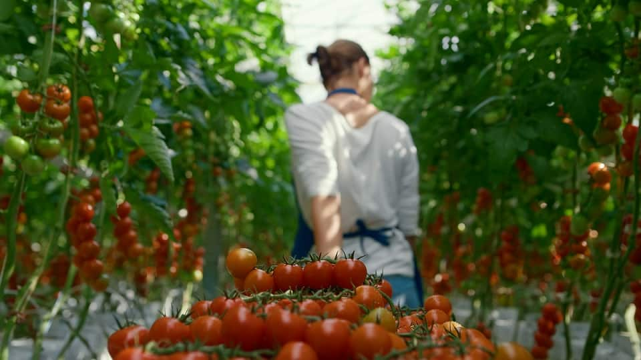
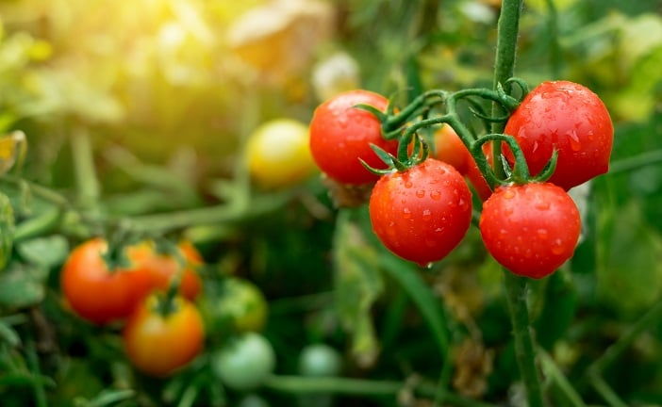
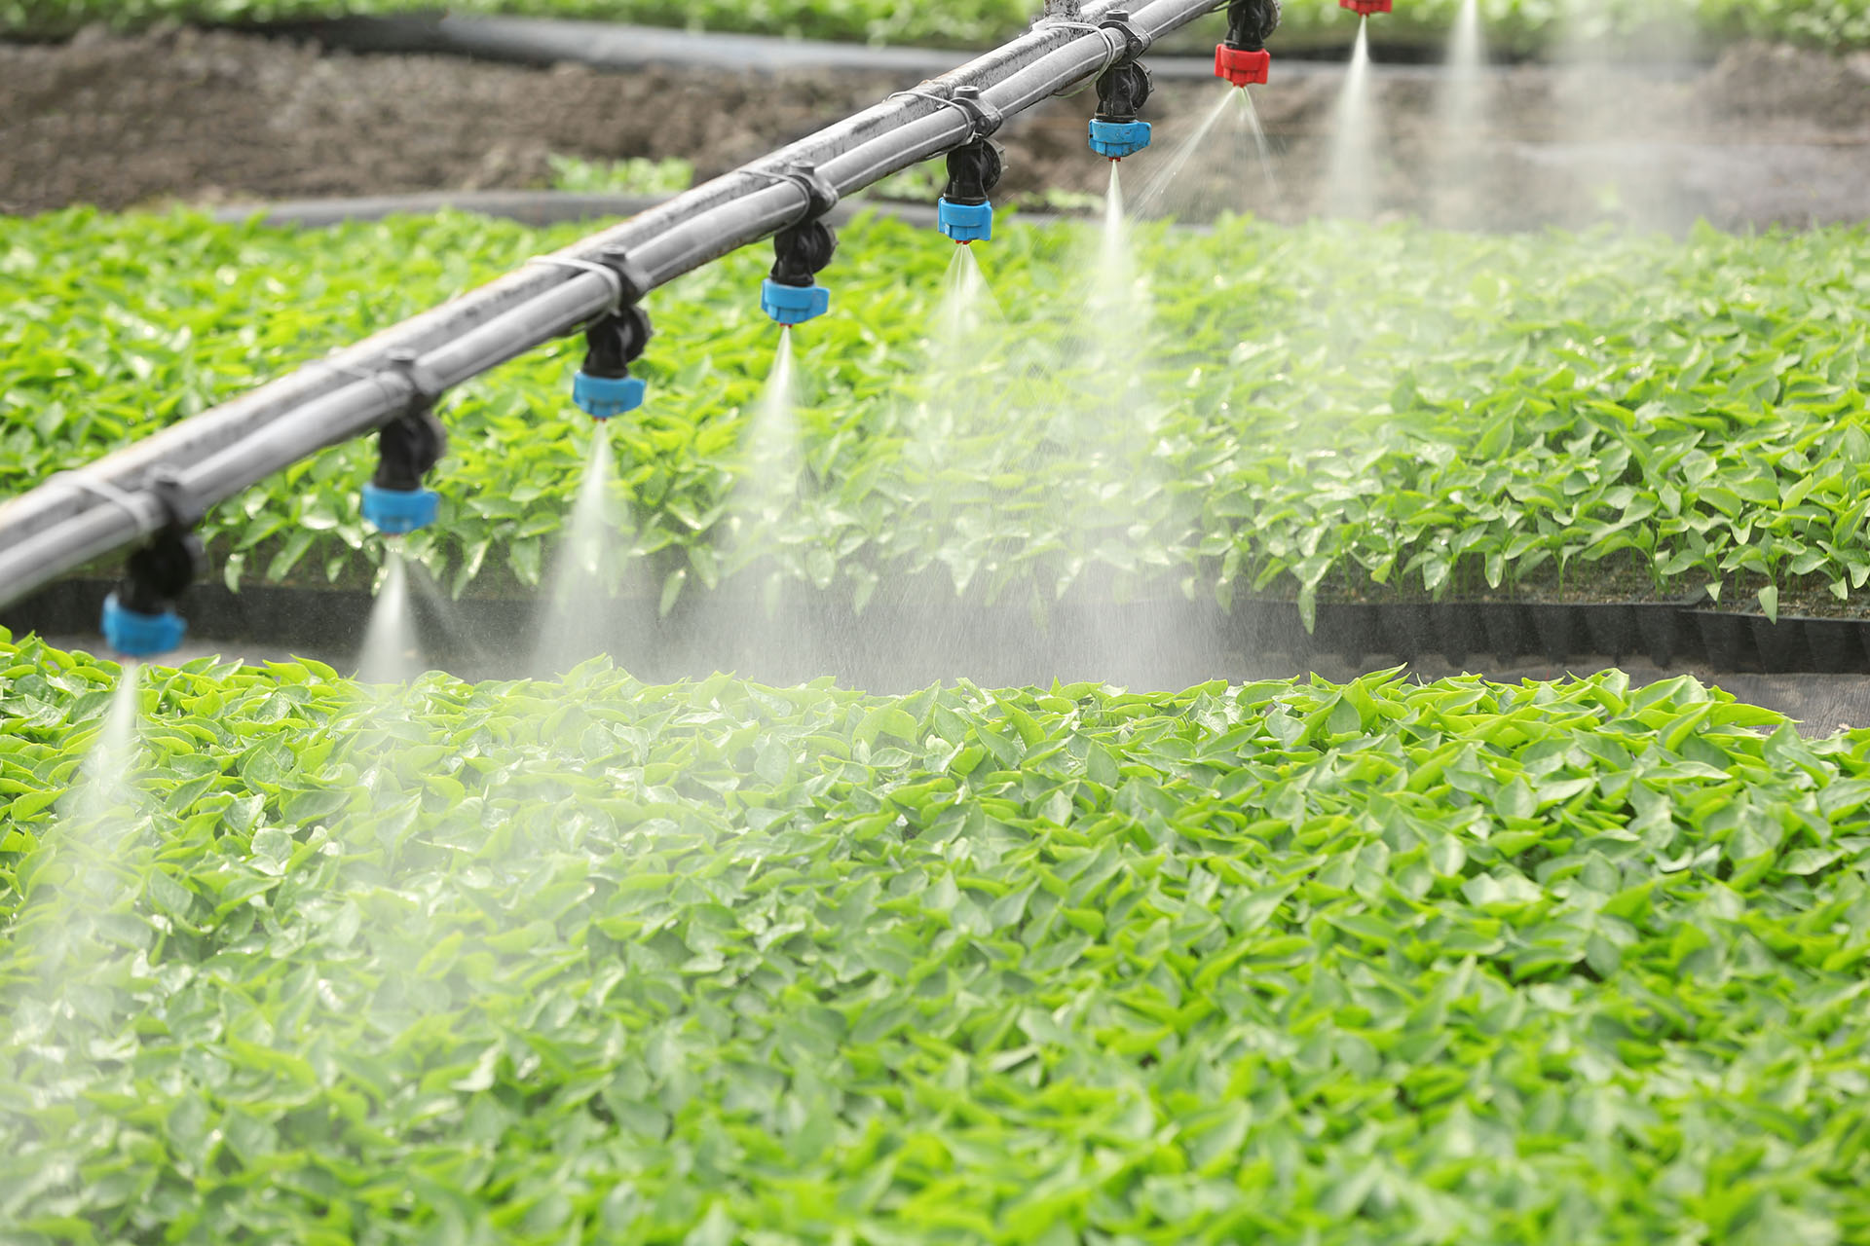
Objectives
The objective is to develop machine learning models that predict optimal fertilizer and irrigation amounts based on plant age, NPK values, and fertilizer type, and evaluate the impact of ensemble learning techniques.
IT21277504 | Padukka P.D.M.D | 24-25J-250
Page 31

Slide 36
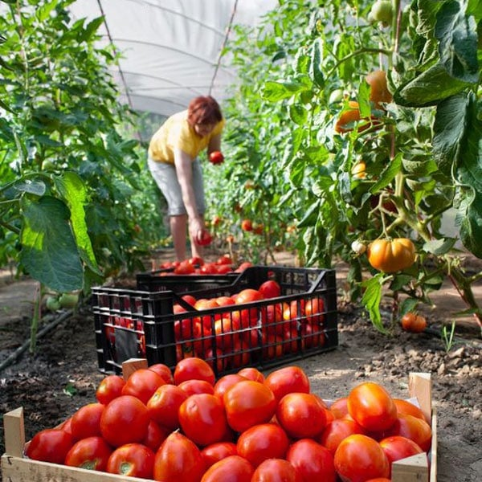
Sub Objectives
01
Resource Usage Optimization
Evaluate the effectiveness of the model in reducing fertilizer and water usage while maintaining optimal crop growth.
02
Real-time data
Use real-time soil data to adjust fertilization rates dynamically.
03
Decision Support System Development
Create a user-friendly interface for real-time monitoring of soil
conditions, including moisture and nutrient levels.
04
IT21277504 | Padukka P.D.M.D | 24-25J-250
Page 32

Slide 37
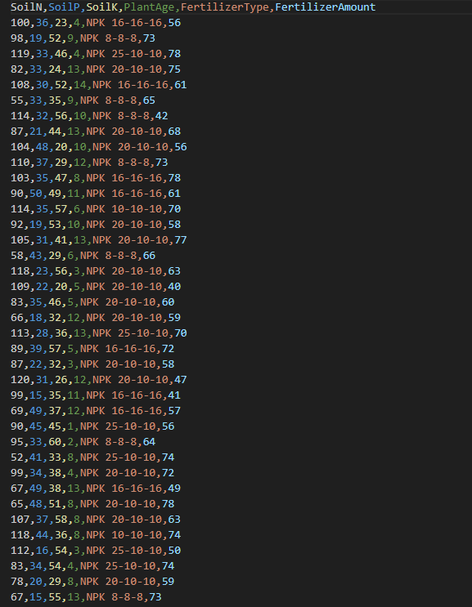

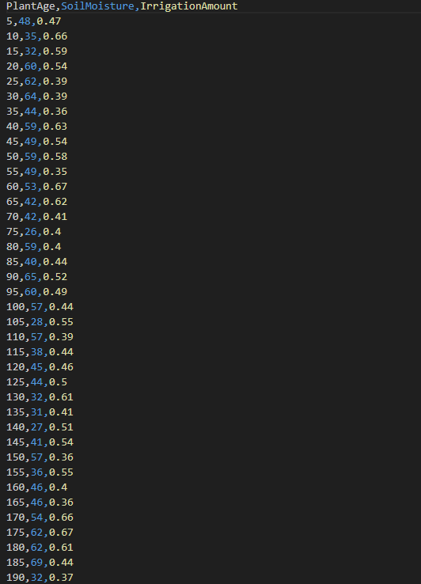
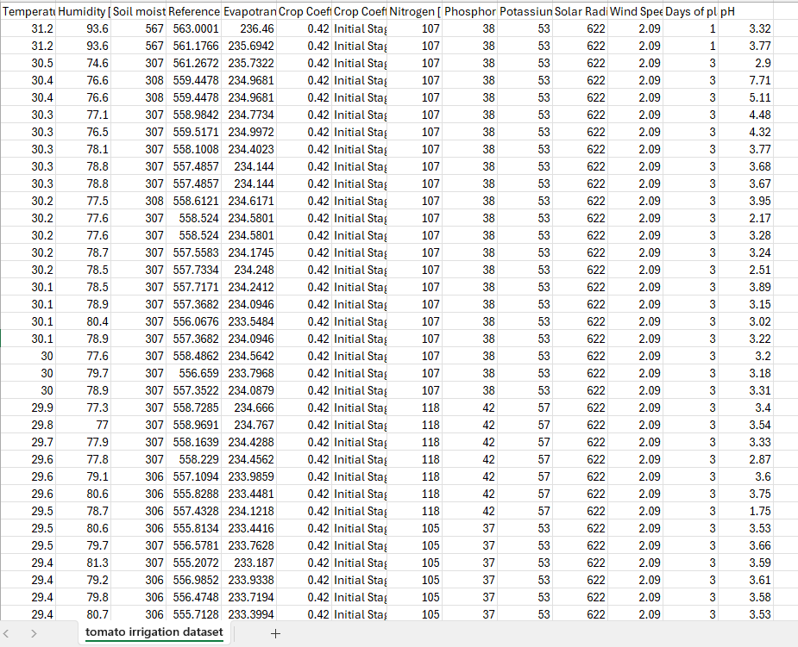
Dataset Collection
IT21277504 | Padukka P.D.M.D | 24-25J-250
Page 34

Slide 38
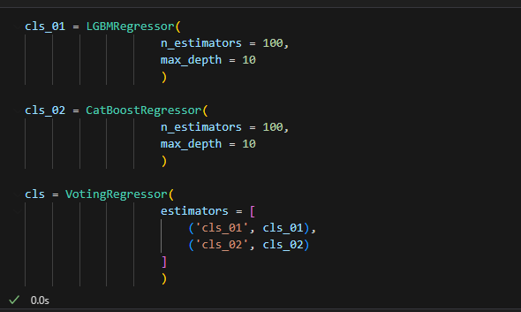
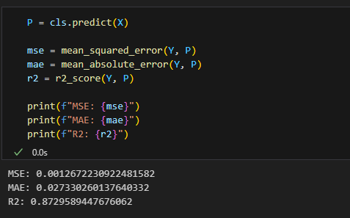
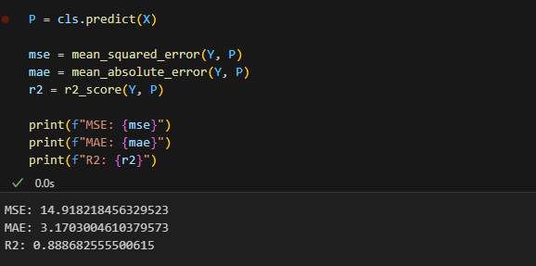
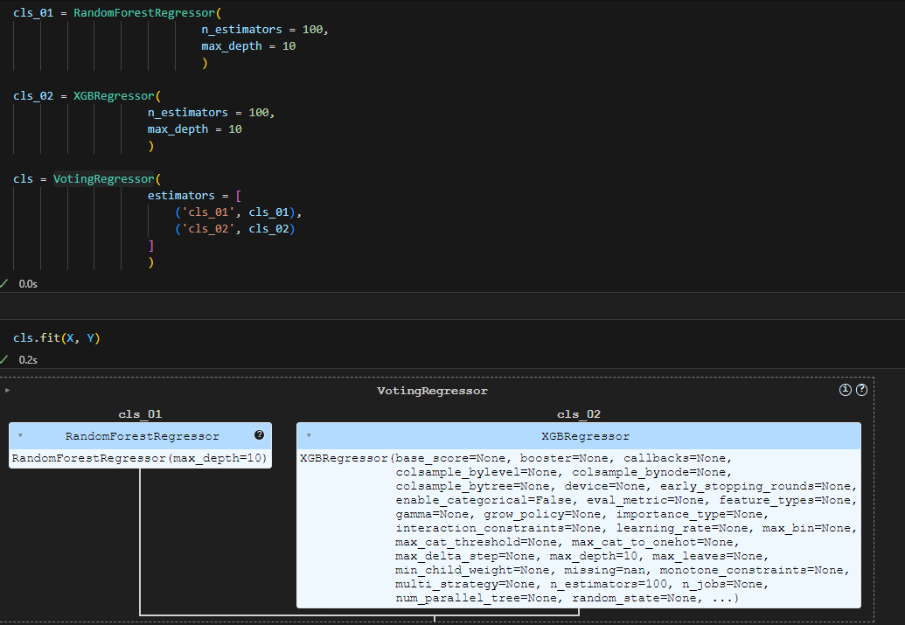
ML Algorithm and Accuracy
Predictive Accuracy – 0.87
Average prediction error – 0.027
Overall error – 0.0012
Predictive Accuracy – 0.89
Average prediction error - 3.17
Overall error - 14.92
IT21277504 | Padukka P.D.M.D | 24-25J-250
Page 34

Slide 39
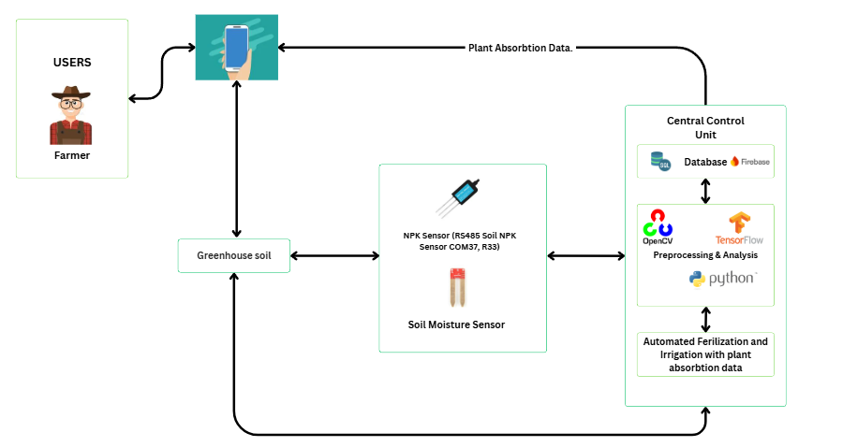
System Diagram
Integrating Trees
IT21277504 | Padukka P.D.M.D | 24-25J-250
Page 33

Slide 40
Completed Function (50%)
Data Collection and Preprocessing
Model Training and Prediction
Smart Farming Techniques
Model Evaluation and Tuning
Result Generation
IT21277504 | Padukka P.D.M.D | 24-25J-250
Page 36

Slide 41
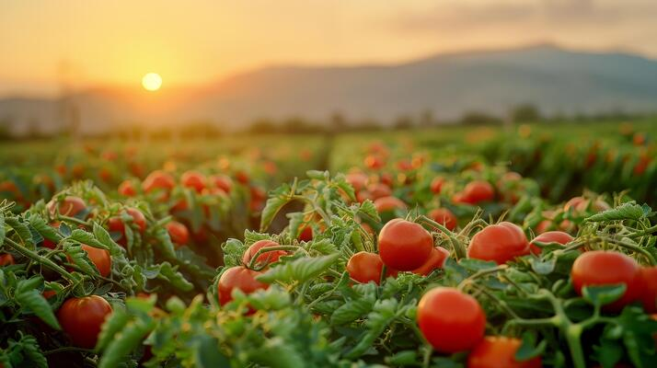
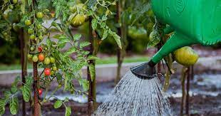
Functional Requirements
Non-Functional Requirements
Data Input and Preprocessing
Scalability
Model Training and Prediction
Reliability
Ensemble Learning
Performance and Speed
Prediction Output
IT21277504 | Padukka P.D.M.D | 24-25J-250
Page 34

Slide 42
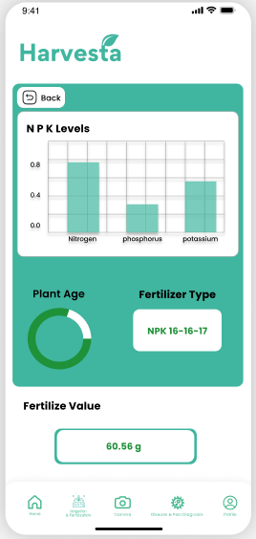

Future work
User Interface Development
Model Deployment
IT21277504 | Padukka P.D.M.D | 24-25J-250
Page 37

Slide 43
Reference
[1] D, S. (2024) Challenges of Greenhouse Labor Management and Automation, Kryzen. Available at: https://kryzen.com/challenges-of-greenhouse-labor-management-and-automation/ .
[2] Fertigation in agriculture: Benefits, methods, and applications (2023) EOS Data Analytics. Available at: https://eos.com/blog/fertigation/ .
[3] Elaydi, H.. (2017). An Automated Irrigation System for Greenhouses. American Journal of Electrical and Electronic Engineering. 5. 48-57. 10.12691/ajeee-5-2-3.
Page 38

Slide 44

Automated Ripeness Sensing with Environmental and Harvest Prediction System
IT21342608 | Kumaravithana D.B
Software Engineering
IT21342608 | Kumaravithana D.B | 24-25J-250
Page 45

Slide 45
Background
This system utilizes cameras for periodic fruit monitoring, analyzing ripeness indicators to estimate the percentage of fruit maturity. A key feature is its ability to predict the best harvest time with high accuracy, ensuring fruits are picked at peak ripeness. Additionally, the system suggests optimal environmental conditions that can be adjusted to enhance the ripening process. These novel capabilities—accurate harvest prediction and tailored environmental recommendations—enable farmers to improve ripeness detection, reduce waste, and maximize agricultural efficiency.
IT21342608 | Kumaravithana D.B | 24-25J-250
Page 46

Slide 46
Research Question?
How can automated fruit ripeness detection improve the accuracy of predicting the optimal harvest time?
01
What impact does machine learning-based ripeness assessment have on reducing waste and increasing farming efficiency?
02
How can suggesting optimal environmental conditions based on ripeness data improve the ripening process and crop yield?
03
IT21342608 | Kumaravithana D.B | 24-25J-250
Page 47

Slide 47
Objectives
To develop and implement a deep learning-based system for the automated detection of fruit ripeness, predict the optimal harvest time, and provide actionable recommendations for adjusting environmental conditions to maximize crop quality and reduce waste.
IT21342608 | Kumaravithana D.B | 24-25J-250
Page 48

Slide 48
Sub Objectives
01
Develop a system that periodically captures images of crops to detect and classify ripeness indicators, enabling precise assessment of fruit maturity levels.
02
Predict the optimal harvest time based on the detected ripeness indicators, ensuring fruits are harvested at their peak quality.
03
Provide periodic recommendations for adjusting environmental conditions to optimize fruit ripening, improving crop quality and reducing waste.
04
IT21342608 | Kumaravithana D.B | 24-25J-250
Page 49

Slide 49


System Diagram
Integrating Trees
IT21342608 | Kumaravithana D.B | 24-25J-250
Page 50

Slide 50
Functional Requirements
Image Input Processing
Ripeness Detection
Harvest Time Prediction
Environmental Condition Recommendations
IT21342608 | Kumaravithana D.B | 24-25J-250
Page 51

Slide 51

Non Functional Requirements
Performance
Reliability & Availability
Usability
IT21342608 | Kumaravithana D.B | 24-25J-250
Page 52

Slide 52
Completed Function (50%)
01
Trained Model
The model has been successfully trained to detect fruit ripeness from images, It outputs the percentage of each ripeness stage, providing an estimate of fruit maturity.
02
Environmental Condition Suggestion
Thresholds have been set for optimal environmental conditions to enhance the ripening process, these thresholds help guide adjustments to environmental factors for optimal ripening.
IT21342608 | Kumaravithana D.B | 24-25J-250
Page 53

Slide 53
Future work
01
Periodic Image Capture Using Cameras
Implement a system for periodically capturing images of fruits using cameras to automate the detection of ripeness at regular intervals.
02
Harvesting Time Prediction
Develop a system to predict the best harvest time based on real-time data
03
Mobile Application Development
Develop a user-friendly mobile application to provide farmers with real-time updates on fruit ripeness, environmental condition suggestions, and optimal harvest time.
IT21342608 | Kumaravithana D.B | 24-25J-250
Page 54

Slide 54

Future work Contd.
01
Mobile UI
IT21342608 | Kumaravithana D.B | 24-25J-250
Page 55

Slide 55

Work Breakdown Chart
Page 56

Slide 56

Grantt Chart
Page 57

Slide 57



Site visit – Gamiya Green House, Galagedra
Page 58

Slide 58

Thank You
Page 59

